Slide 1
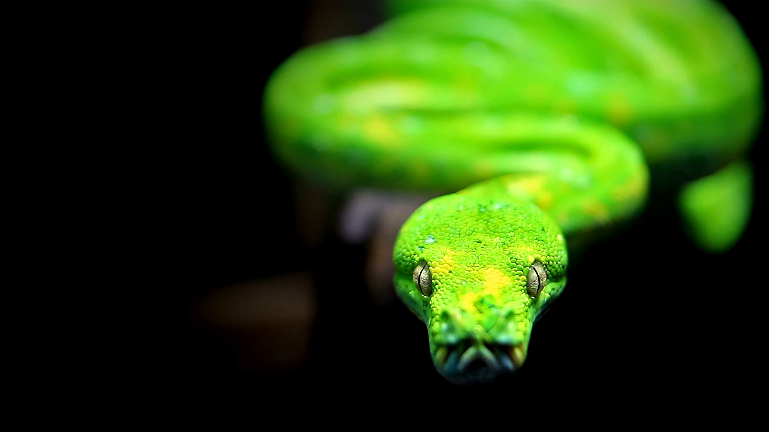
Python Project Management with Poetry
Michigan Python
fosstodon.org/@danyeaw

Slide 2
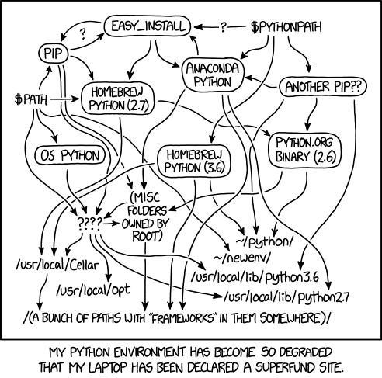
xkcd on Python Environments

Slide 3
Packaging
Software Provider
Distribution
Distribution
Source Code
Working Software
Developer
User

Slide 4
History of Tools and Formats
Build / Distribute
Distutils
Setuptools
Installer
easy_install
pip
Distribution Format
egg
wheel
Poetry
Project Management
2000
2004
2008
2012
2018
2023

Slide 5
Sharing Code with Others
Standalone .py modules
sdist – Pure python Packages
Wheel – BINARY Python Packages

Slide 6
Legacy Methods
setup.py and setup.cfg
requirements.txt

Slide 7

Python Packaging and Dependency Management Made Easy
Installing Packages
Managing Application Dependencies
Packaging Python Projects

